Slide 1
My FRS website
www.myfrs.com
New Hires
ChooseMyFRSPlan.com
Orientation Brochure
Members
Investment Plan Newsletters
Pension Plan Bulletins
Retirees
Investment Plan Termination Kit
PP Retirees Online Services
Benefit Comparison Statement
Online EZ Enrollment Form
Pension Plan Members
Additional Links
Ready, Set, Retire (Pension Plan)
DROP
Additional Links

Slide 2
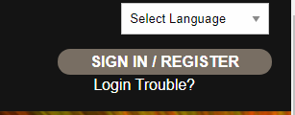
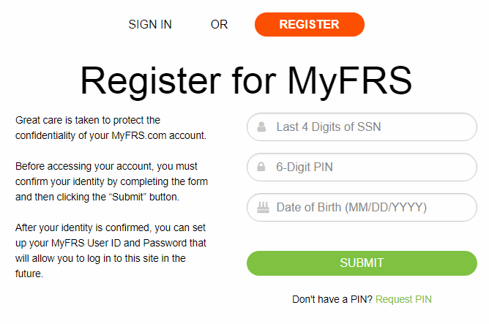
Register for My FRS
Helpful Hint: Your PIN can be found in your FRS New Hire Packet & Orientation Brochure
Misplaced your PIN?
Contact the My FRS Guidance Line to request a new PIN at 1-866-446-9377, option 1
Notes:
Employees can also access their member account via the homepage
Simply click on the link located at the top of the home page to access your member log in
First time users will be required to provide their 6-digit PIN #, located in the New Hire Orientation packet
This packet is typically received around the 60th day of hire, via the mailing address listed in People First
Lost your PIN? Simply contact the My FRS Guidance Line for a PIN reminder or to request a new PIN

Slide 3
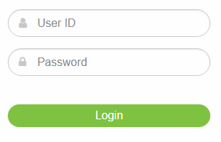
My FRS account
What can I access via My FRS account?
Choice Service
Pension vs. Investment
Comparison Estimates
2nd Election Choice Service
Projected benefit estimates
Possible Pension buy-in cost
Investment Plan Members
Manage their account
Log into your account to receive personalized assistance in making a plan election
What are the financial impacts of switching plans?
Notes:
Once registered, members have access to a variety of online tools.
New employees can utilize the Choice Service to generate a projected estimate of benefits under each retirement plan
For employees considering switching plans, The 2nd Choice Service is available
You may recall this is the one time option provided to all employees to change retirement plans: Pension Plan to Investment Plan or vice versa.
The 2nd Choice Service will allow employees to create projected estimates under both plans to assess the financial impacts of switching plans. The service will also include any out-of-pocket costs incurred by the employee, should they choose to switch plans.
Investment Plan members also have access to manage their account online, including viewing quarterly statements, changing their investment or fund allocations, as well as updating their beneficiaries.

Slide 4
My FRS Resources
Need Assistance Choosing a Retirement Plan?
Review the Plan Comparison Chart for a quick overview of both plans
View the New Hire Video for an in-depth analysis of the plans
Log into My FRS and utilize the Choice Service to create a personalized estimate of benefits under both plans
Contact the My FRS Guidance Line at 1-866-446-9377, option 1
New Hires
Notes:
Need assistance choosing a retirement plan once you are hired at an FRS Employer?
The My FRS website is a great place to review your options
New Hires can initially review the Plan Comparison Chart for a quick overview of both plans, or watch the New Hire Video for a comprehensive overview of both plans
New Hires can also log into their account once they receive their PIN# to create projected retirement estimates for both plans

Slide 5
My FRS Resources
What about my personal finances and investments?
Log in to My FRS and use the Guided Choice Advisor Service to create a personalized retirement portfolio
Utilize Personal Financial Calculators for retirement planning, mortgage loan qualification, saving for college expenses, and more
View pre-recorded Financial Planning Workshops, such as Social Security and Your Retirement, Income Tax Planning, and Taking Control of Your Personal Finances
Members
To sign up for a free workshop, register at MyFRS.com or call the MyFRS Financial Guidance Line at 1-866-446-9377, Option 2
Notes:
There are also a variety of investment and planning tools available to existing FRS members
This includes pre-recorded workshops on a variety of topics, such as “Social Security and Your Retirement”, “Income Tax Planning”, and “Taking Control of Your Personal Finances”
These workshops are hosted by experienced E & Y financial advisors and can be viewed at the employee’s convenience
The Guided Choice Service is also available to help members integrate all their retirement accounts into one centralized location (FRS and non-FRS accounts).
This service will then guide the member through a personal investment strategy, including periodic adjustments, to assist them in meeting their future retirement goals

Slide 6
My FRS Resources
How do I prepare for my upcoming retirement?
Review How to Receive My Benefit to determine when and how you can receive a benefit
Review the Pension Retirement Plan Checklist or Investment Plan Retirement Checklist for a timeline of important steps
Review the FRS Reemployment Guidelines to get acquainted with the rules for returning to FRS employment
Retirees
Notes:
Retirees also have access to helpful resources throughout the retirement planning process
This includes detailed information on when they reach their normal retirement date, as well as their specific options for receiving a benefit
Retirees may want to review the Pension Plan Retirement Checklist or Investment Plan Retirement Checklist, as they consider filing for their benefit
These checklists provide a timeline of important steps, including checking their eligibility for DROP, reviewing their insurance options, reviewing their supplemental retirement accounts, as well as applying for Social Security benefits
Retirees who may be considering returning to FRS employment will need to review the FRS Reemployment Guidelines
These guidelines will help prepare them for the specific restrictions and any monetary consequences for returning to FRS employment too soon

Slide 7
FRS Resources
Educational Workshops for Retirement Coordinators
Investment Plan Employer Training Video hosted by EY financial advisors
Pension Plan Employer Training Video hosted by the Division of Retirement
Additional Tools
Employer Handbooks
plan administration
Employer Newsletters
important deadlines, hot topics, legislation
Employers
Notes:
Employers also have access to two workshops designed to assist them in their respective roles as agency retirement coordinators
These workshops are broken down in two parts: 1) Pension Plan Employer Training and 2) Investment Plan Employer Training
Please note: due to COVID-19 these workshops are being held remotely but are pre-recorded for the employer’s convenience
Employers may also review the Investment Plan Employer Handbook and Pension Plan Employer Handbook online, for answers to questions such as: eligibility, enrollment, plan administration, resources, and employee assistance

Slide 8
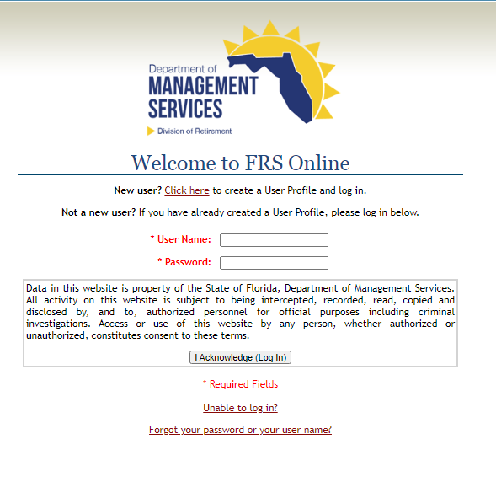
FRS Online
www.frs.fl.gov/login.aspx
If you cannot remember your user name or password click this link and follow the instructions.
Notes:
Pension Plan employees also have access to their account online via the Division of Retirement’s website
This portal can be reached at www.frs.fl.gov/login
First time users will initially provide some identifying information, including their date of birth and social security number
The member will then be mailed a 6-Digit PIN #
The member will then return to the website to set up their user name and password
*** Please note: this PIN # will be deactivated if not used within the first few days of receipt

Slide 9
FRS Online – Pension Members
What can I access via FRS Online?
Years of FRS creditable service
History of salaries (used to calculate your AFC)
Member Annual Statement (available during your birth month)
View and update your beneficiaries
Create retirement estimates, including DROP estimates
DROP participants – final estimate of accruals
Active Members
Why Wait? You can choose to have correspondence from the Division of Retirement delivered to your member account inbox.
Notes:
Active Pension members have access to a variety of important information, including their years of creditable FRS service and Member Annual Statements
These Member Annual Statements are generated by the Division of Retirement, once the member has reached the vesting requirements (6 years or 8 years, depending on the date the member is initially hired into the FRS)
Members also have access to create projected retirement estimates to assist them in retirement planning
Reminder: members may want to review their beneficiary information periodically online, to ensure this information is up-to-date and accurate

Slide 10
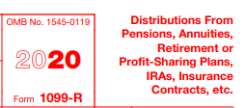
FRS Online – Pension members
What can I access via FRS Online?
View monthly Pension statements
View federal withholding (if applicable)
Determine receipt of monthly Health Insurance Subsidy
View and update beneficiary designations
View and update Direct Deposit
Access 1099R (retiree W2) during tax season each year
Retired Members
Notes:
Retired Pension members will continue to have access to their FRS Online account
This provides them with real-time access to a variety of information, including their monthly Pension statement, insurance deductions, as well as monthly withholding
Retired Pension members may also view and update their beneficiaries online as well as view and print their 1099 R (retiree W2)
Important Reminder: Retirees will automatically receive their monthly Pension via Direct Deposit, based on their current banking information listed in People First
Any changes to a retiree’s Direct Deposit must be made through their FRS Online account

Slide 11
JAC Retirement Coordinators
Jennifer Bond Jennifer.Bond@justiceadmin.org
Jessica Estes Jessica.Estes@justiceadmin.org
We also encourage you to use our email group, Retirement.Coordinator@justiceadmin.org
Notes:
JAC’s retirement coordinators are also available to assist you in answering any retirement questions you may have
Jessica Estes handles retirement for the Offices of the State Attorneys
Jennifer Bond handles retirement for the Offices of the Public Defenders, Criminal Conflict & Civil Regional Counsels, Capital Collateral Regional Counsels, and Offices of the Guardian ad Litem
If one of them is unavailable, please feel free to contact the other, as they serve as each other’s backup
We also encourage you to utilize our Retirement Coordinator email group, where someone is always available to respond to your inquiry.

